Slide 1
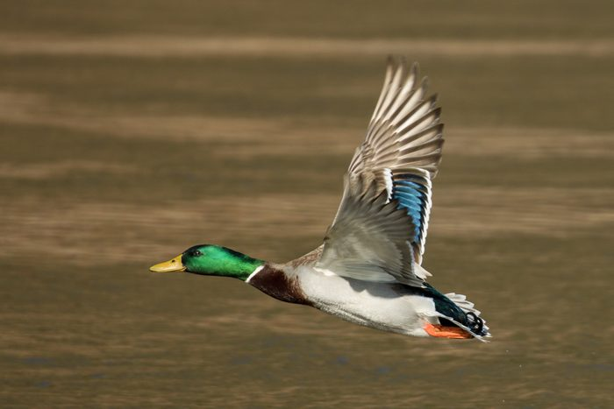
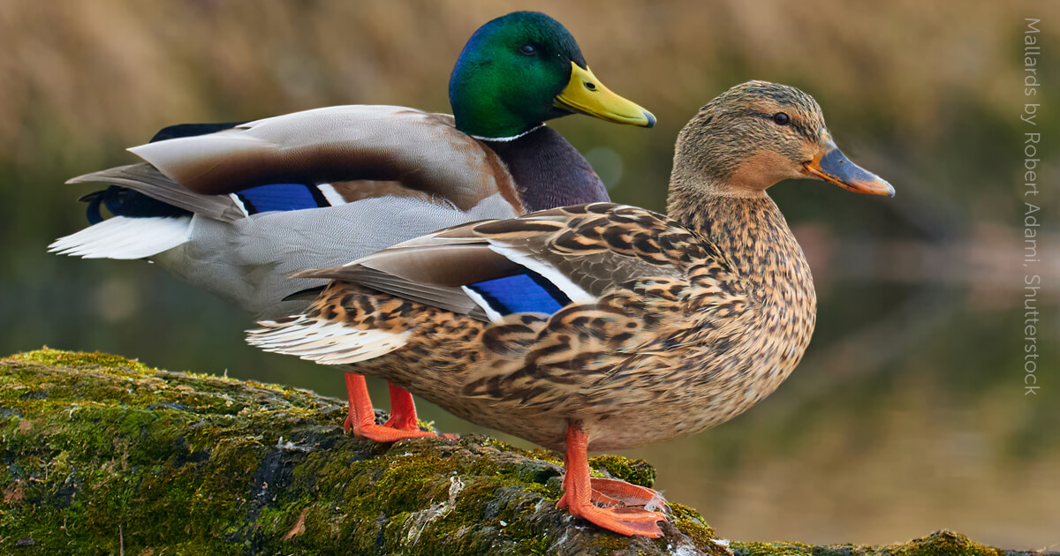
Mallards = Model for all Ducks
Jill Staake
Robert Adami
Cheryl Howell,2022
By: Alex Schmidt, Erik Heidenfelder, Sydney White, Jacob Painter, Tony Vadney
Notes:
Jacob

Slide 2
The Problem
Mallards are the most abundant species of ducks in America ⁹
Mallards are commonly used as the harvesting quota for all other species of duck
Not only used for conservation of dabbling ducks diving ducks too
The harvest quota affects all the other groups that include geese and waterfowl with different ecological niches.
(National Geographic 2010)⁹
Warner Bros. Entertainment
Notes:
The mallard is only one species of duck but the mallard is being used to create harvest quotas for all species. The mallards reside in the dabbling duck group which have very different abundances and habits than the other groups of ducks like diving ducks, geese, and waterfowl.
Jacob

Slide 3
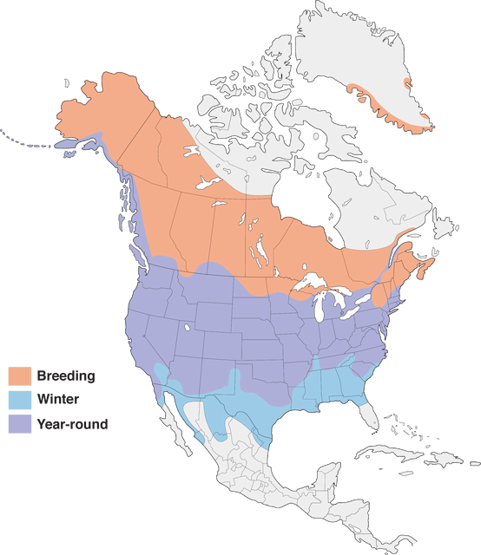
Ecology of the Mallard (Anas platyrhynchos)
One of the largest ranges of any duck in North America, from the highest latitudes in Alaska and Greenland down into Mexico and the Bahamas ²
Found in:
Natural Landscapes: Marshes, bogs, riverine floodplains, beaver ponds, lakes, prairie potholes, ephemeral wetlands ¹²
Built areas: reservoirs, ponds, city parks, farms, roadside ditches, pastures, croplands and rice fields ¹²
(Bent 1987)²
(Cornell Lab of Ornithology, 2022)¹²
University of Alaska Fairbanks
Tumblr
Notes:
Anas platyrhynchos is found in 15+ landscapes marshes, bogs, riverine floodplains, beaver ponds, lakes, reservoirs, ponds, city parks, farms, estuaries, prairie potholes, ephemeral wetlands, roadside ditches, pastures, croplands and rice fields (Cornell Lab of Ornithology, 2022).
Tony

Slide 4
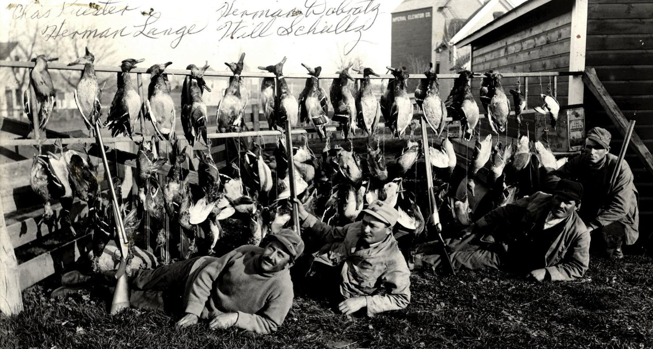
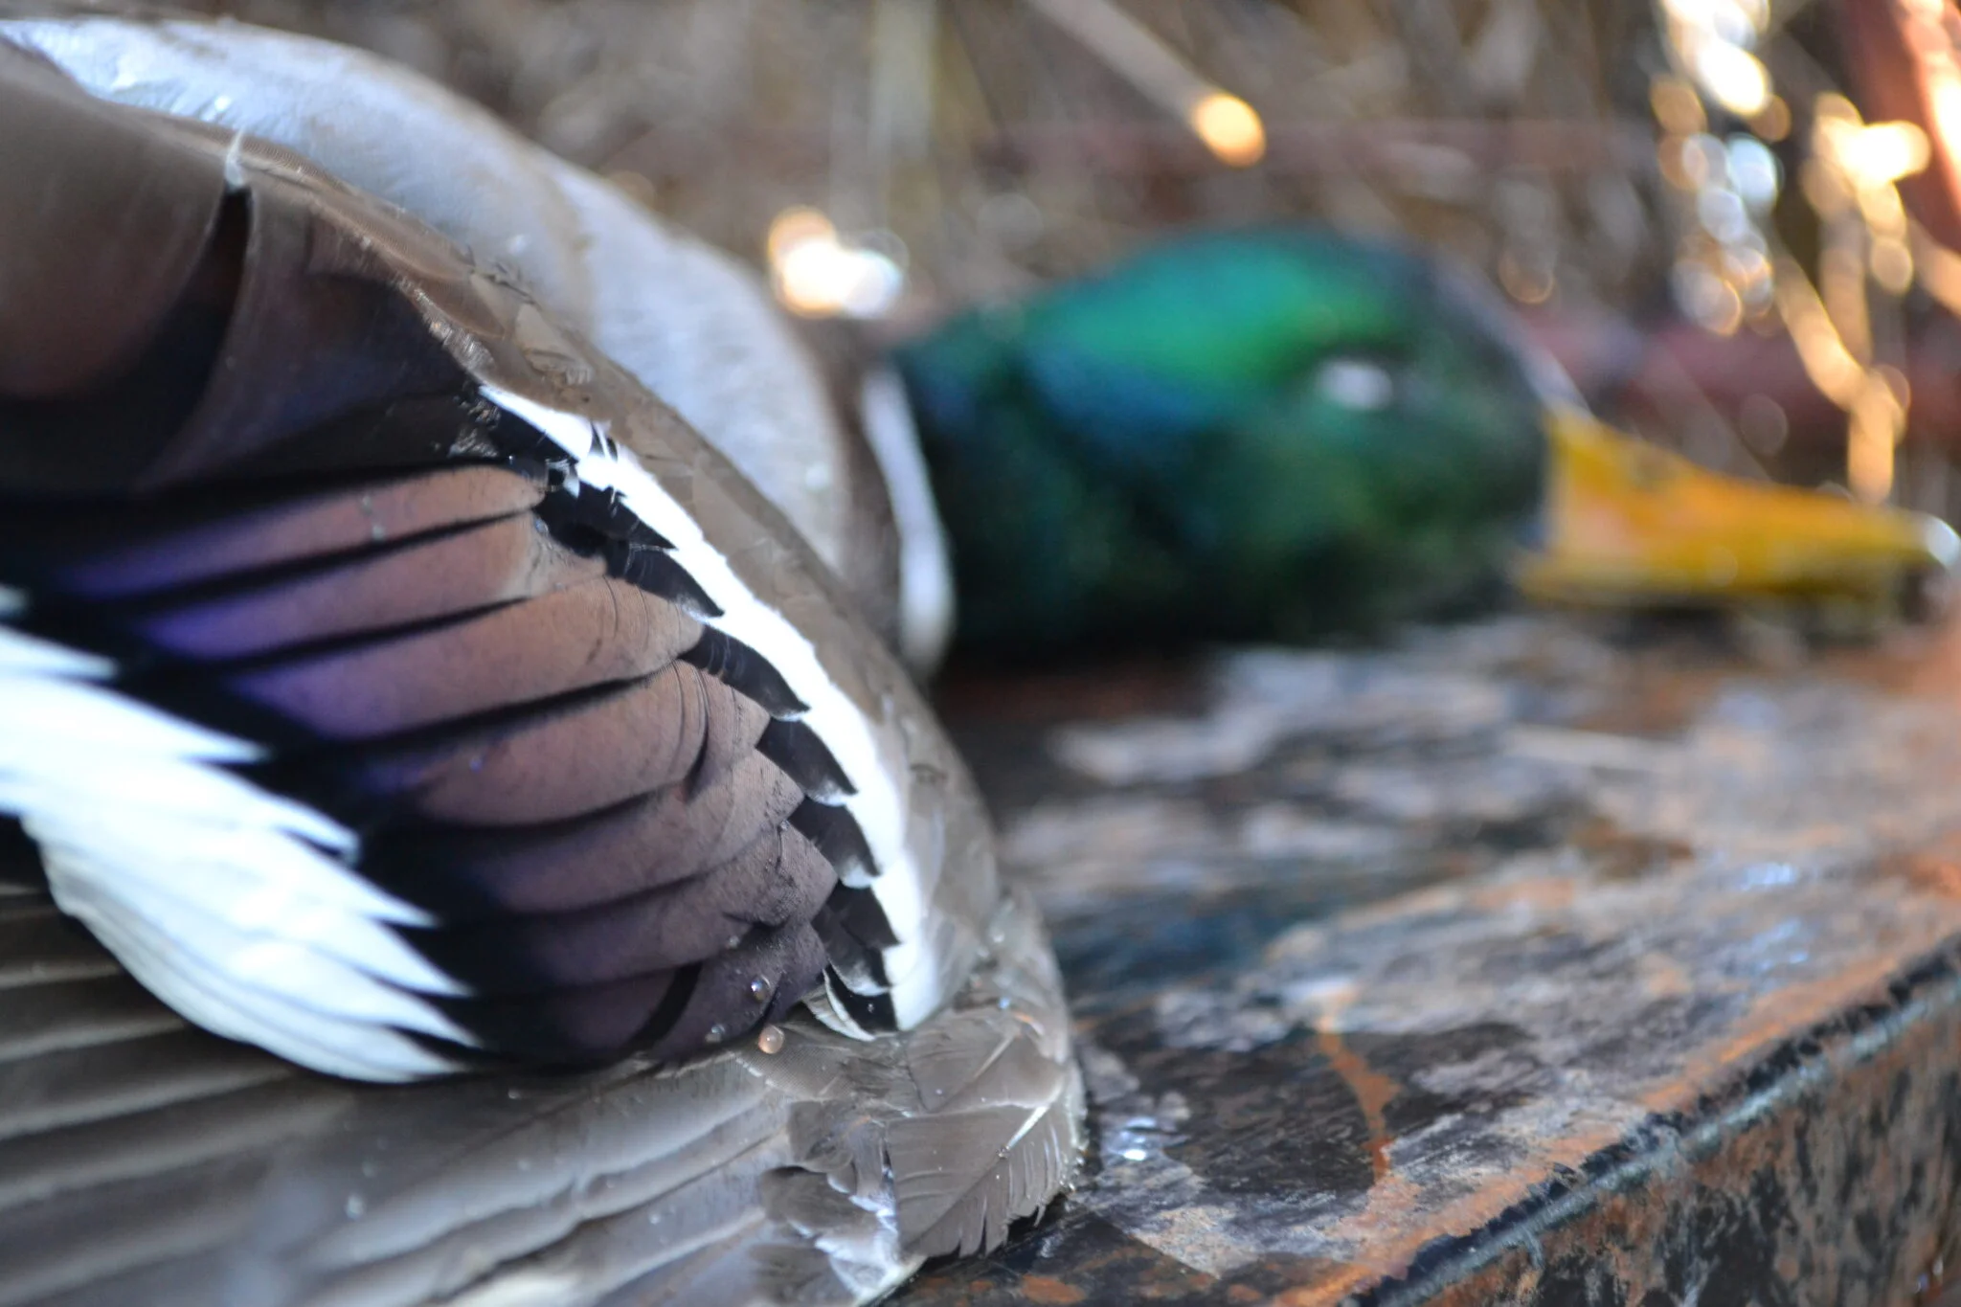
Background
Ducks have been hunted since prehistoric times ³.
In the United States, ducks and other bird species were hunted heavily in the late 18th and 19th century for food and feathers ³
Conservationists began to protect mallards and other species from overharvesting ^{3,10}
USFWS created adaptive harvest management plans as a response to the conservation efforts ^{8,10}
Hutchinson Leader
Ducks Unlimited
(Bowers 2020)³ (Hamburg n.d)⁸ (Roberts et al. 2022)¹⁰
Notes:
Sydney

Slide 5
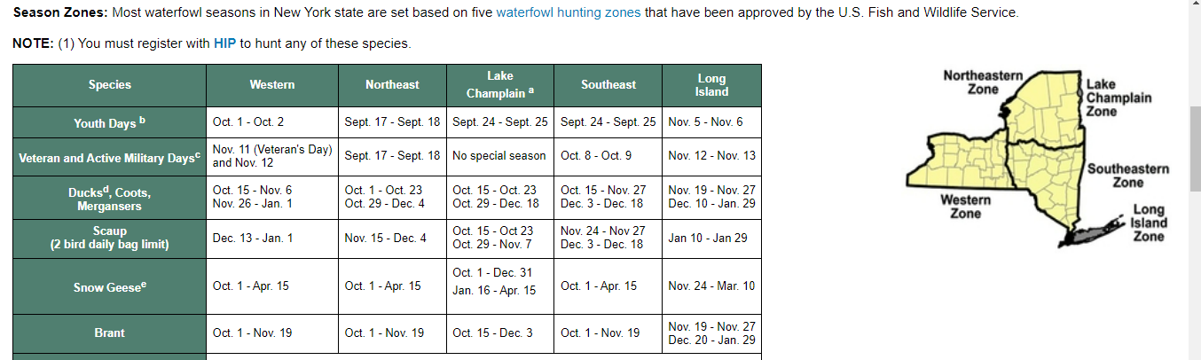
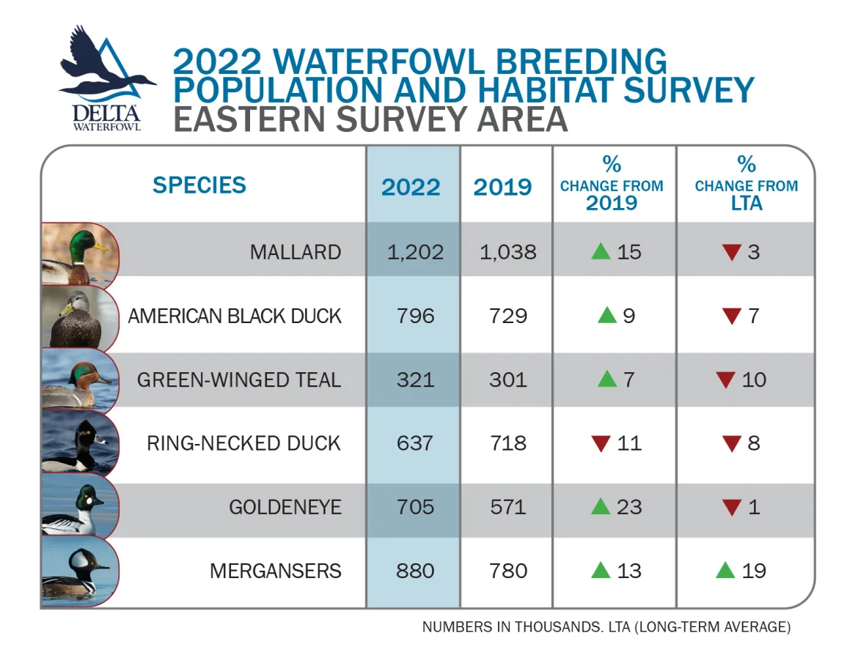
Main Points
1.) Hunting focuses on mallards in regards to hunting length and assigned hunting tags. This is not a good standard due to the number of duck species that are not being accounted for.
Mallards make up 20% or less of the total populations of ducks in the Atlantic Flyway.⁴
Diving ducks, whistling ducks, perching ducks, sea ducks, stifftail ducks ^{5,6}
Mergansers, Goldeneye, Ring-necked duck, - diving ducks ^{5,6}
Green-winged teal, American Black Duck - dabbling ducks ^{5,6}
Hunters currently pay for the tags that create revenue to research the ducks ⁶
Creates demand for more tags regardless if species is declining ⁶
Delta Waterfowl
(Coluccy n.d)⁴
(Ducks Unlimited N.D)⁵
(Gingrich 2022)⁶
NYS DEC
Notes:
Largest populations split between dabbling ducks and diving ducks. Only the mallard is used in creating hunting quotas
Sydney

Slide 6
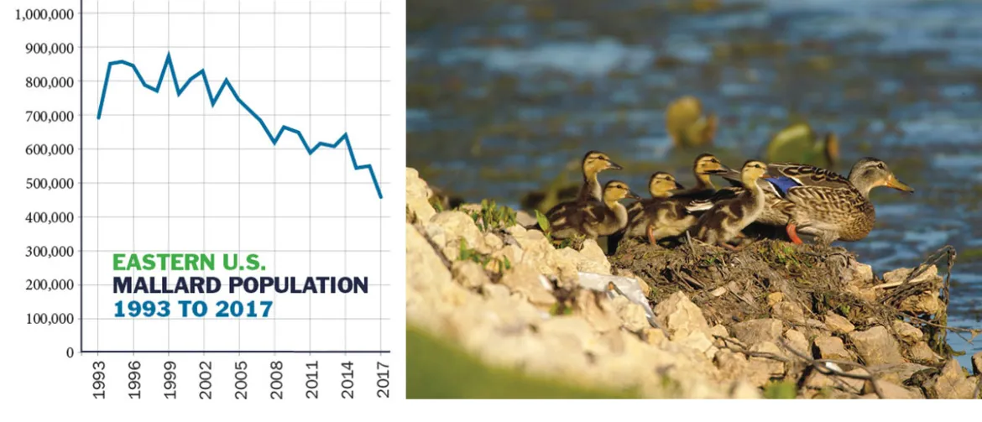
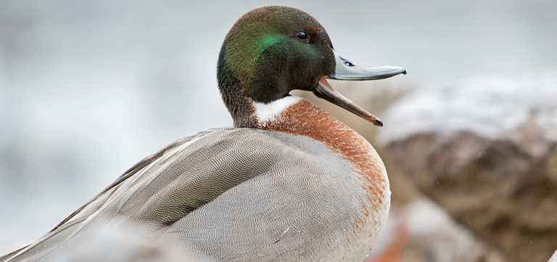
Main Points
2.) The infatuation with mallards harms ecosystem balance and biodiversity.
Overharvesting of mallards has led to population decline in recent years, shrinking bag limits for other species unnecessarily ^{5,7}
Mallards are hybridizing with other ducks affecting the biodiversity throughout ¹¹
Delta Waterfowl
Ducks Unlimited
(Dunn 2019)⁵ (Gingrich 2022)⁷ (Stephens et al. 2019)¹¹
Notes:
Erik: Because of unsustainable harvesting practices, mallards have seen a significant decline in population in recent years, despite the conservation focus placed upon them.
The mallard is also hybridizing with other ducks such as the black duck, northern shoveler, green wing teal and American wigeon, leading to some issues with management especially involving the loss of the pure black duck populations

Slide 7
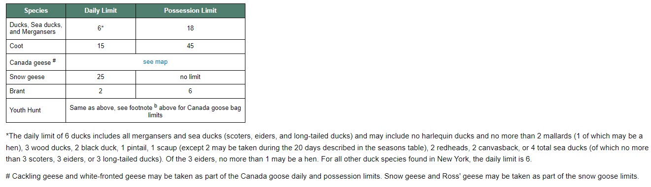
Main Points
3.) New regulations are being put into place to consider more ducks into management and harvest plans, advancing scientific knowledge about species. Monitoring of habits and migration patterns will determine new conservation strategies for different species.¹
4 species are being used to approach harvest management systems of ducks (American green-winged teal, wood ducks, ring-necked ducks and goldeneyes) ⁷
DU has a major role in duck policy ⁷
NYS DEC
(Atlantic Flyway Council 2019)¹
(Gingrich 2022) ⁷
Notes:
Erik: Waterfowl management professionals and organizations like Ducks Unlimited have seen these issues and have begun to introduce more species into the creation of harvest and management plans. 4 more species are now being commonly used to set hunting limits: green winged teal, wood ducks, ring necked ducks and goldeneyes.

Slide 8
Conclusion
Historically, mallards have been the main species that was used to estimate everything to do with ducks
Recently, the USFWS and other state organizations in the Atlantic Flyway have been diversifying their management plans and activities to account for other species of ducks and waterfowl.
To account for the diversification of other ducks and waterfowl, more attention needs to be allocated to the creation and monitoring of conservation of all species
Notes:
Alex

Slide 9
References
Atlantic Flyway Council. 2019. CHANGES IN ATLANTIC FLYWAY MALLARD HUNTING REGULATIONS, 2019-2020. State of New Hampshire, United States www.wildlife.state.nh.us/hunting/documents/mallard-bag-reduction-faq.pdf Accessed 10 November 2022 ¹
Bent, A. C. 1987. Life histories of North American wild fowl. Dover Publications, Mineola, New York, United States ²
Bowers, J . 2020. The Unkown Hisotry of Duck Hunting. Decoy Pro. decoypro.com/history-of-duck-hunting/ Accessed 10 November 2022 ³
Coluccy, John. N.D. Understanding Waterfowl: What's Wrong with Eastern Mallards? Ducks Unlimited. www.Ducks.org. Accessed 10 November 2022 ⁴
Ducks, U. (n.d.). 2022 Duck Population Numbers | 2022-2023 Waterfowl Season. https://www.ducks.org/conservation/waterfowl-surveys/2022/duck-numbers Accessed 10 November 2022 ⁵
Dunn, Claire. 2019. SUNY ESF. 50% Decline in Mallard Population Sparks Research Efforts. https://www.esf.edu/communications/view2.asp?newsID=8567 Accessed 10 November 2022 ⁶
Gingrich, T. December, 2, 2022 Telephone interview ⁷
Hamburg, D. N.D. How The Seasons Are Set. Ducks unlimited www.ducks.org/hunting/waterfowl-hunting-regulations/how-the-seasons-are-set Accessed 10 November 2022 ⁸
National Geographic. N.D Mallard www.nationalgeographic.com/animals/birds/facts/mallard Accessed 10 November 2022 ⁹
Roberts, A., J Hostetler, J. Stiller, P. K. Devers, W. Link, and G. S. Boomer. 2022.Eastern Mallard Adaptive Harvest Management Strategy, 2022. Fish and Wildlife Service, Laurel, Maryland, United States ¹⁰
Stephens, K., J. Measey, C. Reynolds, and J. Le Roux. 2020. Occurrence and extent of hybridisation between the invasive Mallard Duck and native Yellow-billed Duck in South Africa. Biological Invasions 22. ¹¹
The Cornell Lab. N.D. All About Birds, Cornell Lab of Ornithology, Cornell, New York, United States https://www.allaboutbirds.org/guide/Mallard/lifehistory# Accessed 10 November 2022 ¹²
Photos
https://www.uaf.edu/toolik/edc/guides/bird-guide.php?bird_id=21
https://snakes-stims.tumblr.com/post/650944434187436032/mallard-ducks-1-2-3-4-5-6
https://www.crowrivermedia.com/hutchinsonleader/news/entertainment/more-to-the-story-a-bit-of-duck-hunting-history/article_b9eb5971-7e5f-58b9-b883-b73d64b54880.html
https://deltawaterfowl.org/2022-duck-survey-numbers-released/
https://www.ducks.org/conservation/waterfowl-research-science/waterfowl-hybrids

